Slide 1
Archaeogaming as Queergaming
Florence Smith Nicholls
@florencesn

Slide 2
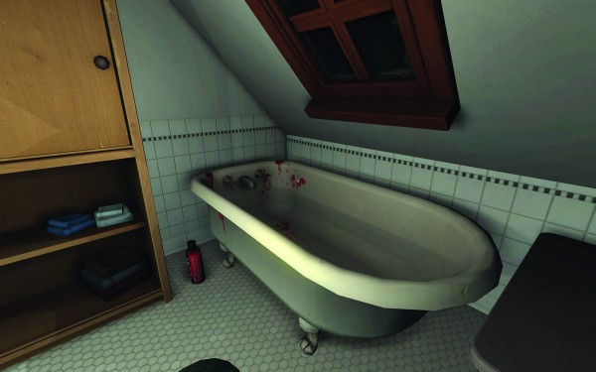
What happened here?

Slide 3
What is archaeogaming?
Praxis
Representation
Archaeogaming
(Reinhard 2017)
(Dennis 2016)
Creation
(Copplestone 2017)

Slide 4
What is queergaming?
Praxis
Representation
Queergaming
(Chang 2017;
Brieal M-T 2018)
(Nakamura 2012)
Creation
(Engel 2017)

Slide 5
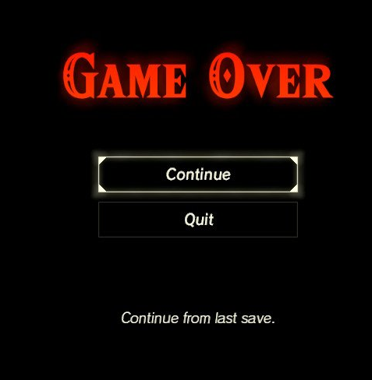
Permadeath/permalife
Ruberg (2017) Permalife: Video games and the queerness of living

Slide 6

Queers in Love at the End of the World
Anna Anthropy (2013)
https://w.itch.io/end-of-the-world

Slide 7
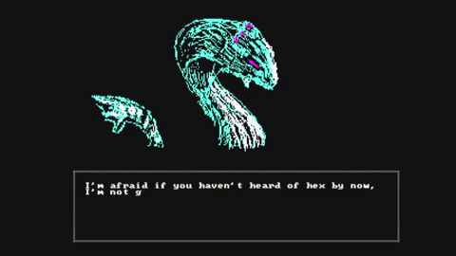
Forgotten
Sophia Park (2016)
https://sophiapark.itch.io/forgotten

Slide 8
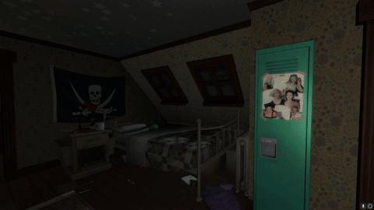
Gone Home
Pavlounis (2016) Straightening Up the Archive:
Queer Historiography, Queer
Play, and the Archival Politics
of Gone Home
The Fullbright Company (2013)

Slide 9
What happened here?

Slide 10
Archaeogaming as Queergaming
Florence Smith Nicholls
@florencesn
https://florencesmithnicholls.wordpress.com/

